Slide 1
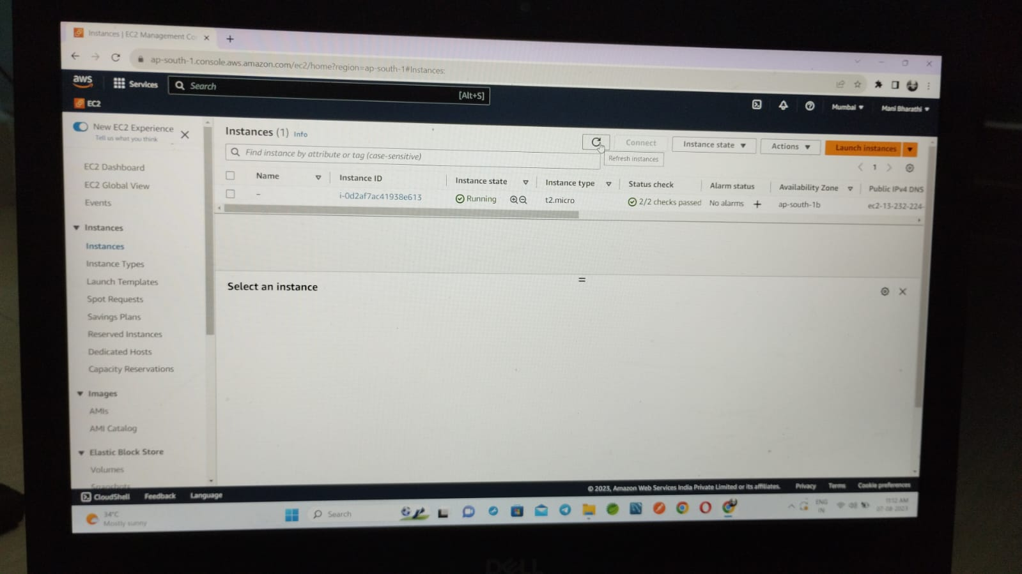
Create a instance in no name

Slide 2
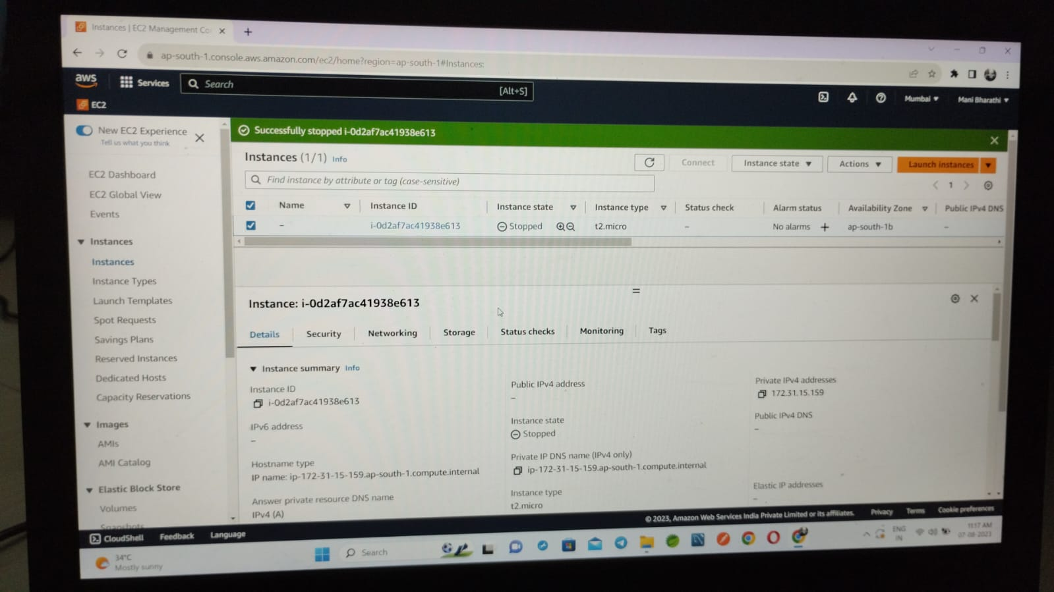
Instance Stopped

Slide 3
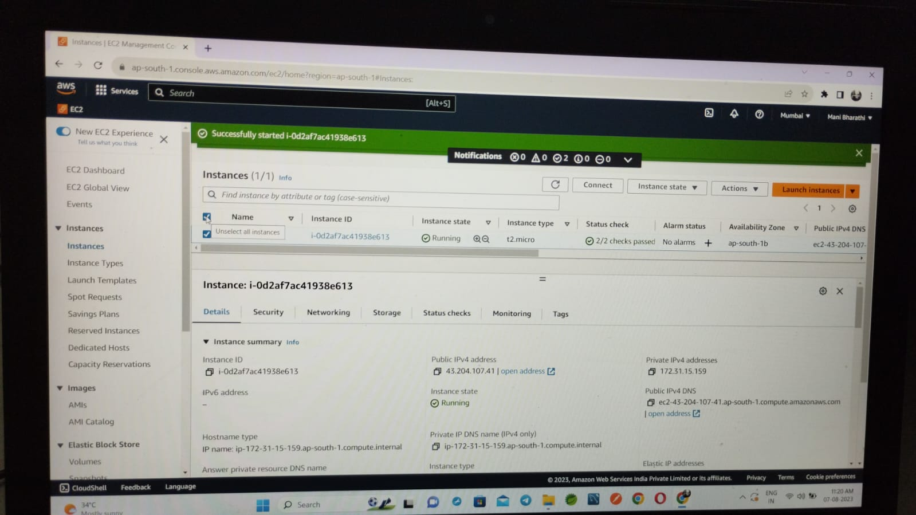
Again we start a same instance. The ip address will changed

Slide 4
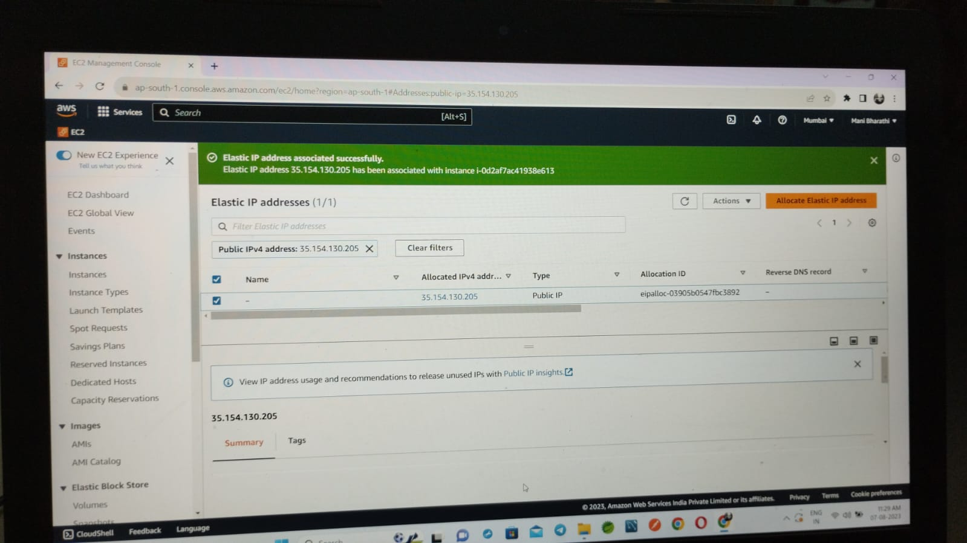
EC2 ip address is associated

Slide 5
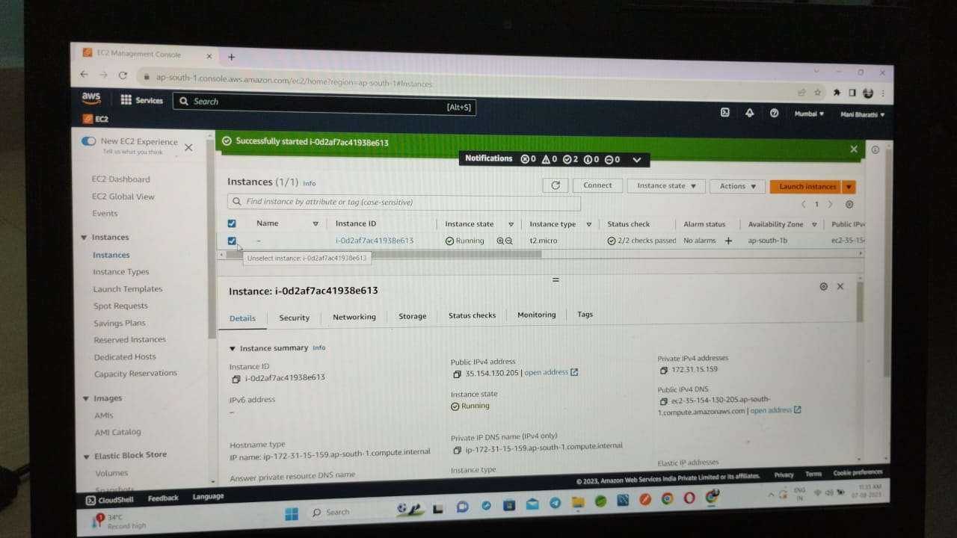
Elastic ip is changed

Slide 6
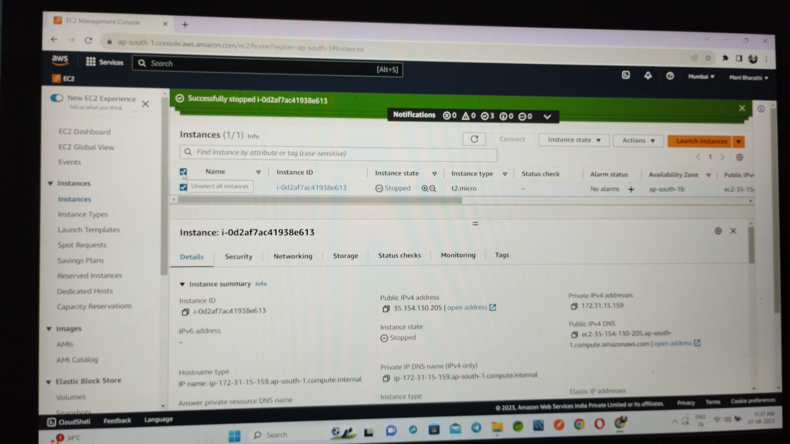
We have to stop the instance again the public ip address is still there

